Slide 1
EcoActUs (Ecology Action for Us)
Sustainability Leadership Workshop
Notes:
Participants have already decided to attend a Showing. (go to next slide)
General Audiences/Contemplators are fresh faces to EcoActUs and perhaps to the Climate Crisis. Their deck adds a quick review of the Climate Crisis (a few slides from Climate Reality Project). Jump to end of this section + 1 slide.

Slide 2
EcoActUs (Ecology Action for Us)
Introduction to Sustainability Leadership Workshop
Climate Boot Camp
<<TITLE>>
<<DATE>>
Notes:
<<TITLE>> <<DATE1>> - <<DATE3>>
Think about a “hook” That’s a beginning that hooks people’s attention. Grab their interest. A personal story of how you got engaged, what caused you to think about it. Perhaps a startling fact, maybe an example. Raise their pain level and sense of need that the training will answer.
Winston Churchill, on change, said:
To improve is to change;
To be perfect is to change often.
Change toward perfection is an iterative process. Particularly in complex issues, time for iteration is important. But don’t get bogged down in attaining perfection at the expense of good enough. However, Good Enough is not mediocre.
WELCOME
With the tools found in EcoActUs you will equip yourself to understand change and to assert your newfound knowledge within a framework of change inside an organization. If you are not currently inside an organization that has directed you to engage in sustainable action, then imagine that you will be or that an organization you already are in, needs to consider sustainable action. Go through the course acquiring knowledge and gain an understanding of both the environmental crisis along with tools for instigating change in organizations, independent of the specific cause you are promoting.
By completing the EcoActUs training, you will have taken a significant step toward climate sustainability action.
BASICS
Today I’ll provide some basic background around the history of EcoActUs development, its mission, and a bit about the educational methodology. You’ll see a live demo of the tool, including the eWorkbook. With this background you should feel comfortable in beginning your self-paced journey.
SCHEDULE, SMALL GROUPS & CERTIFICATE
I’ll also introduce the general schedule, including the 2 Small Group Discussion sessions planned and how to obtain your Certificate of Completion.

Slide 3
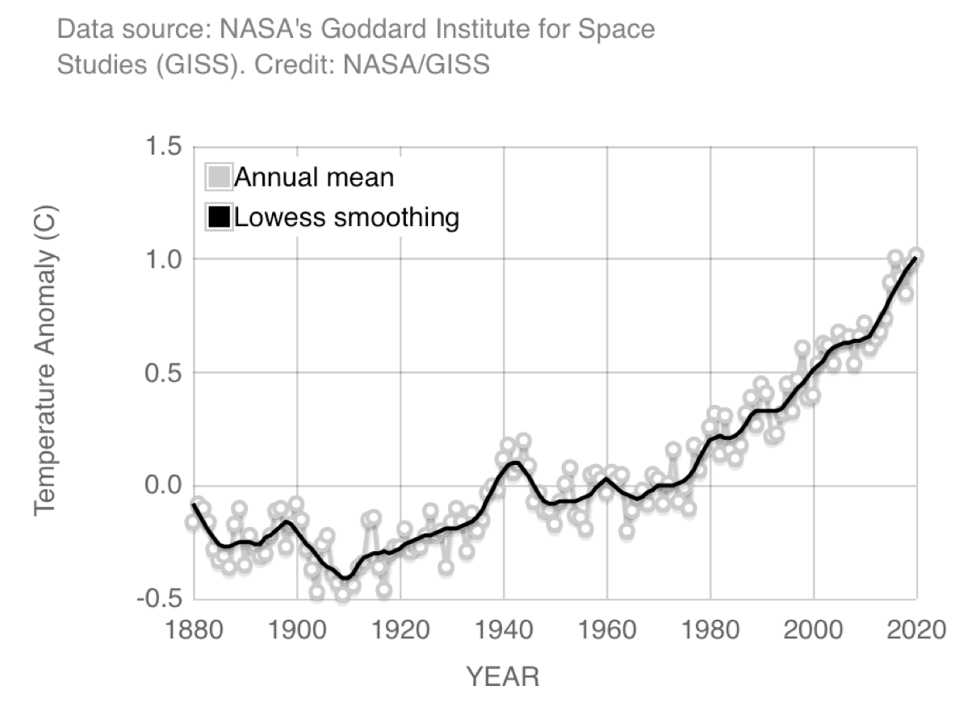
EcoActUs The Climate Crisis
Notes:
Suggested text:
“Just so we’re all on the same page…” Let’s review a couple of slides regarding the Climate Crisis. This might want to focus on Organizational Crisis (as opposed to the Contemplator Track which can be more general)
Here’s the problem; global temperature increase has been steadily increasing since about 1950. And this is a reflection of atmospheric carbon dioxide (and other GHG) levels.

Slide 4
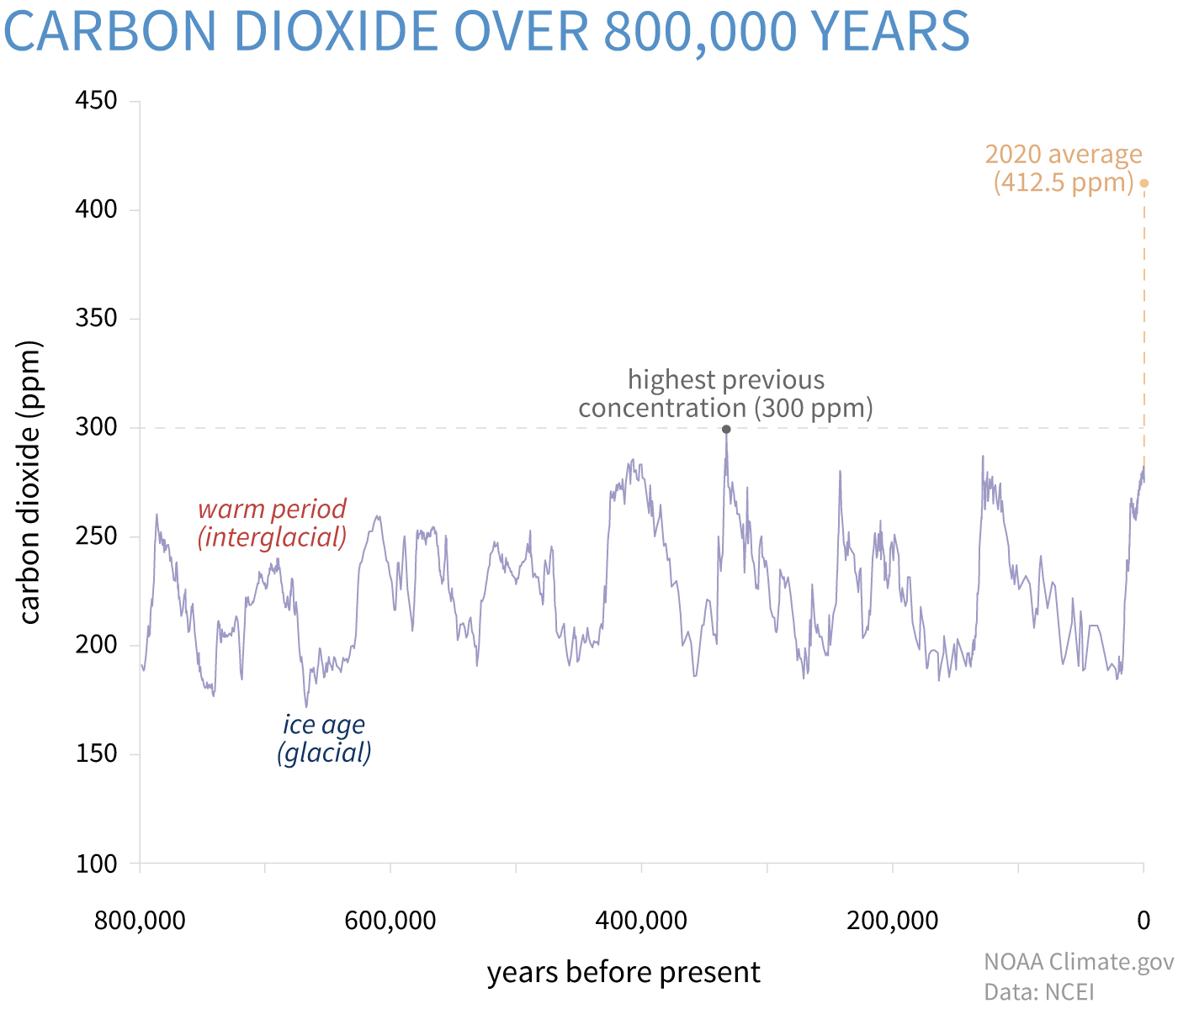
EcoActUs The Climate Crisis
Notes:
This graph shows carbon dioxide levels, with the most recent ones recorded at Mauna Loa observatory in Hawaii. This graph shows the levels up to year 2020 at 412 ppm. Since this graph was created, the highest carbon dioxide level ever recorded at Mauna Loa was 421 ppm, recorded on Feb 14, 2022. We have to go back 2.5 million years to find CO2 levels this high. At that time sea level was 20 meters higher than now and the Artic was about 59ºF warmer than it is today.
If all the glaciers and polar ice melted it’s estimated that sea level would rise 230 feet. Fort Worth is at 653 feet.

Slide 5
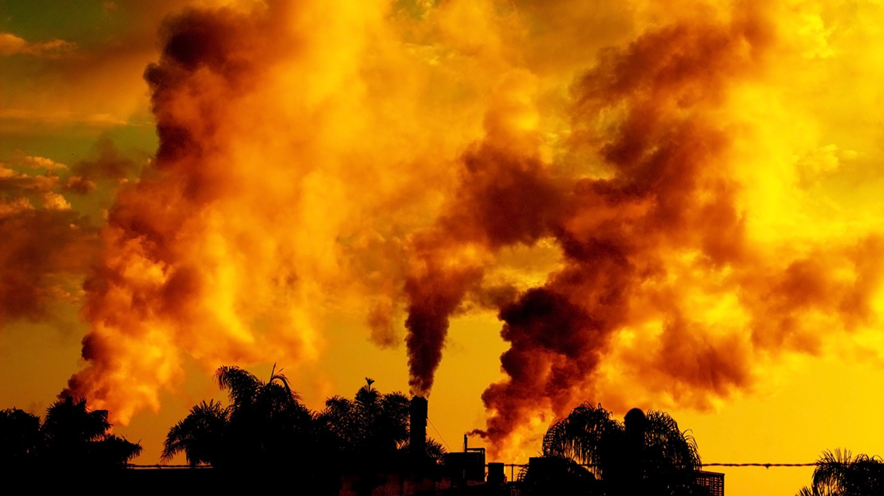
EcoActUs The Climate Crisis
We are spewing 162 million tons of manmade global warming pollution into the thin shell of our
atmosphere every 24 hours — as if it were
an open sewer.
Notes:
And we’re dumping 162 million tons each day into the atmosphere.

Slide 6
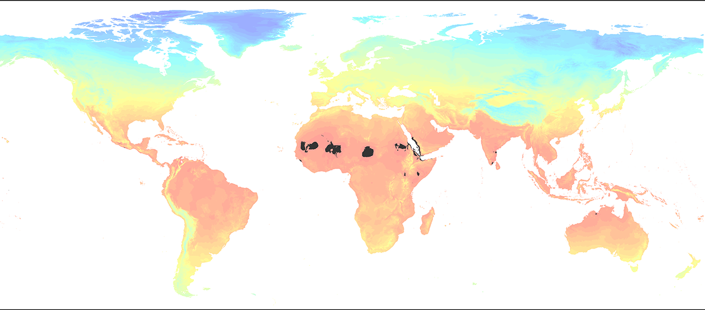
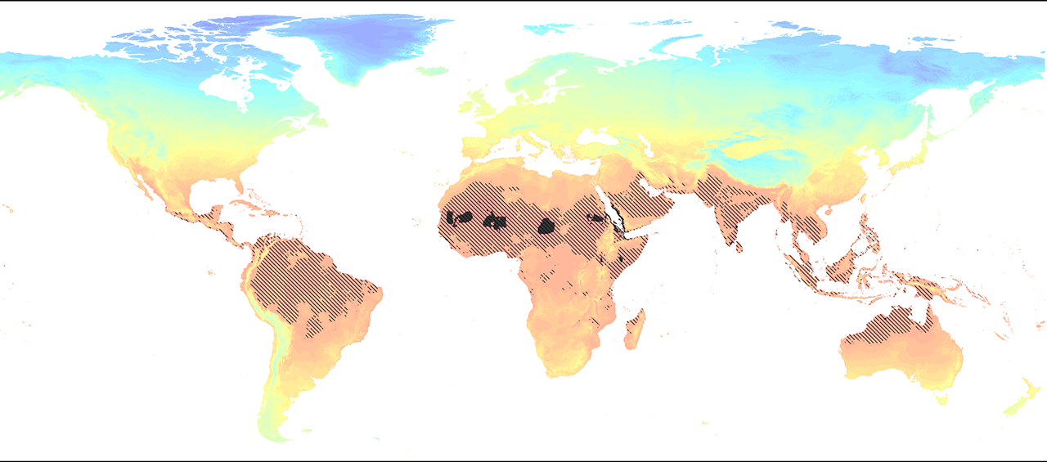
Earth’s “Uninhabitable” Zones
Current Conditions
By 2070
Data and Graphic: Chi Xu, et al. “Future of the human climate niche,” PNAS, May 26, 2020
Notes:
Here are the current and (click) predicted uninhabitable zones of the earth. These are areas where the WetBulb temperatures are high enough that humans cannot survive outside for more than 2 hours because the body can’t cool itself through evaporating perspiration. And people will be leaving these areas because they are just too inhospitable.
So now we know a bit about WHY we need to get activated. And, by the way, the WHO and the UNs, IPCC (Intergovernmental Panel on Climate Change) report, recently summarized findings from around the global:
One * The planet is facing a crisis of unprecedented magnitude
Two * The impacts of climate change disproportionally impact vulnerable and disadvantaged communities
Three * Current GHG emissions continue to rise and current plans are not ambitious enough to limit temperature change to less than 1.5ºC (2.7ºF) and thus prevent a global catastrophe
Four * We have only a few years (not even centuries) to act
Five * And luckily, every country has agreed with the basic tenet that we need to work on this crisis
As Bill Gates noted in an analogy; once the bathtub is full, you must stop adding any water if you want to prevent an overflow. Substitute carbon dioxide for water and atmosphere for bathtub and you can see where we are. Natural processes will reduce carbon dioxide in the atmosphere, over time, but it’s a slow process; but we need to stop filling the bathtub.
ID #6589 - Can be used in noncommercial online and TV broadcasts of your presentation, but not modified.
Here are the areas that are deemed uninhabitable today on Earth. By uninhabitable, what the scientists say is that if the combination of the heat index or the WetBulb temperatures, if it gets above a certain level, humans cannot survive for more than two hours outside. Because the core of the human body can’t cool itself down. We weren’t intended to live in conditions like that. Goldilocks planet, we’ve got no more use for Goldilocks, we’re just going to change everything. Anyway, this is what it does to the uninhabitable zones over the next less than 50 years. Again, you can see the Indian subcontinent, lots of the southeast Asian archipelago, Laos, Cambodia, large parts of Africa and South America, and Central America. And people pick up and leave, of course they do!
DESCRIPTION: Map depicting Earth’s “uninhabitable” zones under current conditions and projected conditions by 2070
SLIDE SOURCE(S): https://www.washingtonpost.com/weather/2020/05/04/human-climate-niche/?itid=hp_world1-8-12_climate-change-420pm%3Ahomepage%2Fstory-ans

Slide 7
EcoActUs Our Mission
Who are we?
What can we do?
Enable individuals - then Organizations for Effective Environmental and Regenerative Action
Understand Causation
Activate Individuals
Activate Organizations
“From knowledge comes action”
Regenerative state
Notes:
We are a group of volunteers, brought together with the aim of bringing a credible tool to as many individuals, and hence organizations, as possible. A joint effort of Climate Reality Project and Harvard Alumni for Climate and the Environment which brought together some of the strongest minds in environmental science and in organizational change. Over 1,000 individuals have taken the training and more showings are scheduled.
So WHAT can we do, and more specifically what is EcoActUs doing...
* Help individuals understand the root causes of the environmental crisis (Climate Reality does a really good job of helping us all understand the problem and EcoActUs takes the next step to help us know how to lead our organizations into action)
* What we as individuals can do about it
* Organizations, working on solving these problems can do what individuals can only dabble in; and together organizations can produce the kind of global action needed for the climate change crisis
Our goal is to educate people and organizations in order that they can bring the planet back to a regenerative state...
* In the past, the earth and its living systems were regenerative. Everything created by life was recycled; broken down and reused.
* The processes of life regenerate the requirements for life; plants take in carbon dioxide, producing oxygen. Animals take in oxygen and produce carbon dioxide. When in harmony, a balanced and self-sustaining, self-regenerative system is created
* Even geologic processes are regenerative; the continental plates push together raising mountains which are slowly weathered away
So our thinking should be focused on creating regenerative processes, a more ambitious goal than “sustainability”, if the planet is to support 8, 9,10 B people. We must become regenerative.
And in this resetting of our economic and social goals let’s not forget that the current climate crisis affects disadvantages communities more strongly than anyone else. Let’s use this time to left all people up so that everyone has access to clean water, clean air, affordable, resilient housing and sustainable jobs.
In doing so, we will have done our best to pass on, to our children and their children, a beautiful, safe and habitable environment for all.

Slide 8
EcoActUs Regenerative Thinking
Notes:
Here’s an example of regenerative thinking in the area of Regenerative Agriculture.
Here are the principles:
* concentrate on the health of the soil,
* On biodiversity,
* the quality of your water, and
* the social and economic equity for the people who are working on the farms and all those who are connected to the operation.

Slide 9
EcoActUs Schedule
Introductory session (<<DATE1>>)
Self-paced learning
5 Sessions and Session 2 offers 6 technology tracks
Small Group Action Session #1 (<<DATE2>>)
Review of Session 1 & 2
Small Group Action Session #2 (<<DATE3>>)
Review of Session 3, 4, & 5 (closing)
Small Group Action Sessions
Networking
Questions
Further individual Action Plan
Notes:
<<ORGANIZATION>> <<DATE1 - DATE3>>
The material is largely self-paced, but some structure helps. Suggested structure:
An Introductory Session
Then self-paced learning
5 Sessions (which will look at in a minute); Session 2 has 6 technology tracks; you may not need to view all 6
A Small Group Action Session #1
A second Small Group Action session #2
These Sessions help participants network with others, ask questions, and further their own Action Plan development

Slide 10
EcoActUs Curriculum Overview
Sessions
Introducing the Situation
Strategies that Work…
Challenging the Status Quo
Road to Change
Building Support
Tracks
Transportation
Built Environment
Energy Use
Industry
Circular Value Chain
Food & Ecosystems
Other
Curated References
Media
Movie
Art
Music
Notes:
We’re going to walk through the actual web site in a minute, but let’s look at what’s available…
There are 5 Sessions…
Introducing the Situation - what are the root causes and what must we do for our society to survive
Strategies that Work - a drill down on the technologies your organization may need to become regenerative. This includes detailed references to each of the technologies built into 6 tracks
Challenging the Status Quo - how you can challenge your organization, your family and friends, associates to change to a regenerative economy
Session 4. Road to Change - how you can build the roadmap for your organization to become regenerative
Building Support - how to engage people and build their commitment to create a regenerative economy
Dwight Eisenhower said,
Motivation is the art of getting people to do what you want them to do
Because they want to do it.
Finally, Other material available to you, includes Curated References, along with Media in Movies, Art and Music.

Slide 11
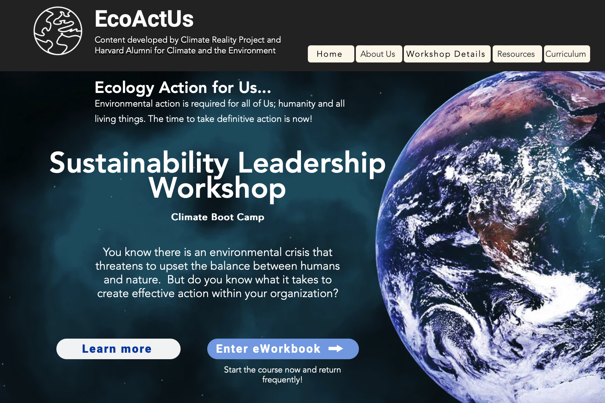
EcoActUs Orientation to Website
EcoActUs.org
Notes:
Landing page EcoActUs.org
If website available, skip to slide 36 (otherwise next slides show website screen shots)
Website orientation (Live demo, if possible)
Start at EcoActUs.org (landing page, after login)
Review Participant’s Guide (Action Plan specifically)
Video introduction (play if time allows)
Start eWorkbook (log in or create an account; remember to use the same email at each login)
Five major sessions (1 - 5), Progress (if available), Certification of Attendance, CR Hub
Point out upper left Other Media strip, navigation back, personal info, logout
An important set of references in EcoActUs are the Media links. Film, Art and Music resources can be found here. Check back to the website as new material is created and we add additional links like the 2 shown here.
Progress bars, journey visualizer
Session 1 / Introduction to the Situation
Start review, after Action Plan, Explore, “Climate Emergency: Feed back Loops”
Session 2 / Transportation
Each session has a standard format and Big Opportunities and Extended Reading are an example
Session 5
Show video on eWorkbook: Investing in Sustainability Offers Strong Growth and an Attractive Future; Session 5 0:15:21 (play through 0:18:30 or to end if time permits) and 1:19:50
We just looked at President Calderon 0:15:20 through 0:18:30. Each lecture session is indexed like this one so you can jump to a specific speaker.
Fun and Playlist (start TEDxLA Louie Schwartzberg, if time permits)
After each Session or Track, take the Quiz. After you’ve taken each quiz for the 5 sessions and at least one track quiz, you may apply for the Certificate of Completion.
Complete your own Action Plan as you go along, jot notes, references, contacts… as you begin to formulate your organization’s plan
Complete the imbedded Action Plan as you go along, or you may want to use the Action Plan Template to jot notes and begin to formulate a plan for your organization. [put this back when the Action Plan is working]

Slide 12
EcoActUs Speaker Highlights
• Ken Berlin, President & CEO, The Climate Reality Project (retired)
• Tim Guinee, Actor, Climate Reality Leader
• Hubert Joly, Harvard Business School (prior Best Buy CEO), author Heart of Business
• Dana Gunders, NRDC, co-author Wasted
• Andy Lipkis, Founder, Accelerate Resilience LA and TreePeople
• Bill Weihl, Executive Director, Climate Voice (prior Google CSO)
• Dan Schrag, Director Harvard Center for the Environment, Harvard Kennedy School
• Dr. Jonathan Foley, Executive Director, Project Drawdown
• Christie Gamble, Senior Director of Sustainability, CarbonCure Technologies
• Gina McCarthy, White House Advisor on the Environment
• Felipe Calderon, Former President, Mexico
• George Serafeim, HBS
• Heather Henriksen, Chief Sustainability Officer, Harvard University
• Bruce Shaw, Executive Director, Denny Center, Georgetown Law
• Anthony Leiserowitz, Sr. Research Scientist, Yale School of the Environment
• Shane Goodwin, Dean, Cox Business School, SMU
• HG Chissell, Founder Advanced Energy Group
• Marianne Mensah, Lecturer Climate Education, Université Côte d’Azur
• Christa Gyori, CEO and Co-Founder of Leaders on Purpose
+ 20 other experts

Slide 13
EcoActUs Q&A
Questions?
info@ecoActUs.org
Notes:
Remember, you may start at any time and go through at your own pace.
We’ll meet back in the scheduled small group sessions next Saturday and the following Saturday OR
If your group has scheduled specific sessions then be sure to attend those. Your local facilitator will have communicated with you.
If you have problems, email… info@ecoActUs.org

